Slide 1
ICT
Lecture 3

Slide 2

Email Etiquette
This is a discussion on email etiquette, with a focus on forwarding etiquette

Slide 3
What is etiquette?
The rules which indicate the “correct” way to behave in a certain time and place.
Email etiquette is especially important in the work place
Notes:
Example: When in the work place, there are appropriate and inappropriate ways to use email.

Slide 4

6 Basic Email Etiquette Rules

Slide 5
Rule #1: Always include a subject and use the recipient’s name in the greeting
Why is a subject important?
It informs recipient what the email is about.
Make it short and to the point, i.e.: “Fee Waiver Question” or “Admission Requirements”

Slide 6
Rule #2: Do not write in ALL CAPITALS
Writing in all capitals can convey that you are shouting in your message, and nobody likes to be yelled at. Consider other ways to get your message across while conveying its importance. Using all capitals can be annoying and trigger an unintended response.

Slide 7
Rule #3: Greetings!
Always begin your email with a proper greeting:
Dear Eliza Jones,
Ms. Jannifer
Professor Carter.
This establishes the tone of the message and respect for the recipient
If emailing a department or office, use “to whom it may concern:” as such emails are often read by an office assistant before being forwarded to the appropriate individual.

Slide 8

Rule #4: Do not use email to discuss confidential information

Slide 9
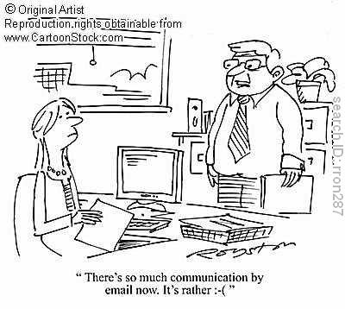
Rule #5: Take care with abbreviations and emojis ☺
Save abbreviations like LOL (laugh out loud) or IDK (I don’t know) for text messages among friends.
Some may not understand your abbreviations
Not professional

Slide 10
Rule #6: THINK before you send
If you answer yes to all of these questions:
Is this relevant to the work my organization is doing?
Will the office benefit professionally from this information?
Okay to send!

Slide 11
But if you answer NO to any of these…
Could this information hurt/embarrass/offend someone?
Email should not be used for confrontation/yelling/reprimanding
Could this email be misinterpreted in a bad way?
Is this information important to share in the workplace?
Could this email get me into trouble?
Do NOT send!

Slide 12
What is the purpose of email in the workplace?
Quick communication
Share PROFESSIONAL information
Keep records of communication
It is NOT for:
sharing funny email forwards that your friends send you
sharing political or religious views
harassing coworkers
inappropriate conversations
Do Not share your Password or Credit Card Number

Slide 13
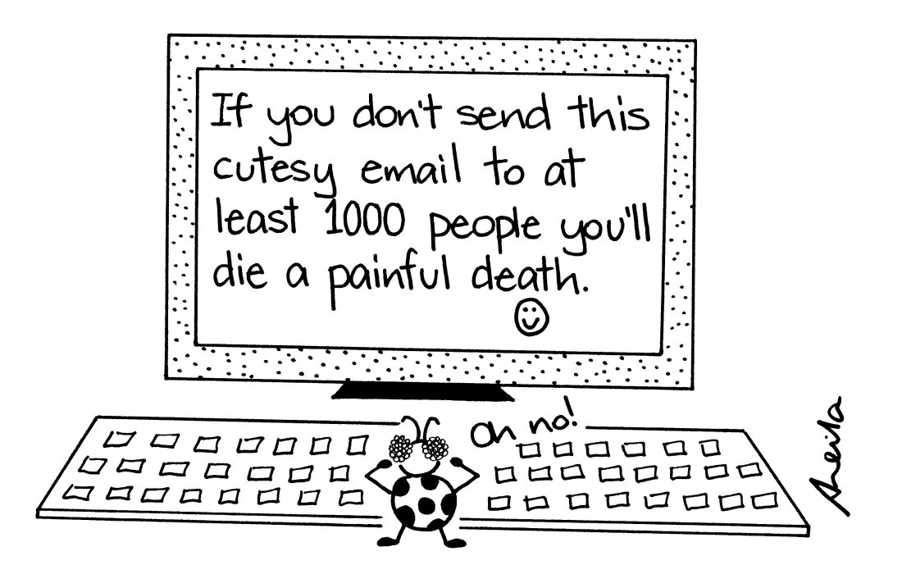
Rule #6: Do not Forward unnecessary/unrelated Emails

Slide 14
Grammar, Spelling and Punctuation
Always reread your email a few times to find grammatical and spelling errors
Spell check: all email accounts should come with this feature. Use it!
Avoid using all capital letters which may come across as yelling. “How are you?” Is much more professional than “HOW ARE YOU?”

Slide 15
Rules for Forwarding
Think carefully about if what you are forwarding will be of value, appreciated or humorous to the person on the other side.
If an email tells you to “Forward to everyone you know/love/all of your family” do NOT forward
Notes:
Value-accurate information
Appreciated- something the recipient needs
humorous (do they have the same sense of humor as you do)
If you cannot think of why the person you are forwarding to would like to receive the email – then don’t forward it.

Slide 16
Forwarding
Is it a good idea to forward emails that promise money or goods?
Should you forward emails to as many contacts as possible?

Slide 17
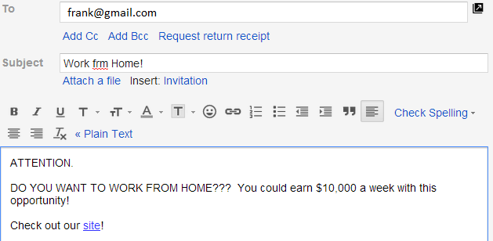
Example 1: Would this email be relevant to someone?

Slide 18
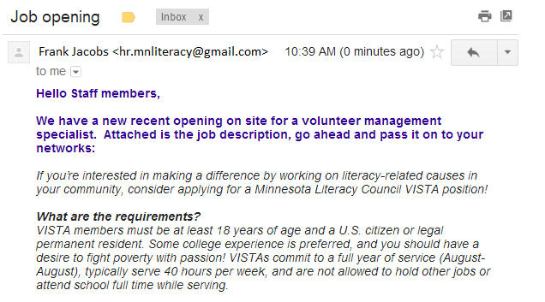
Example 2: Would this email be relevant to someone?

Slide 19
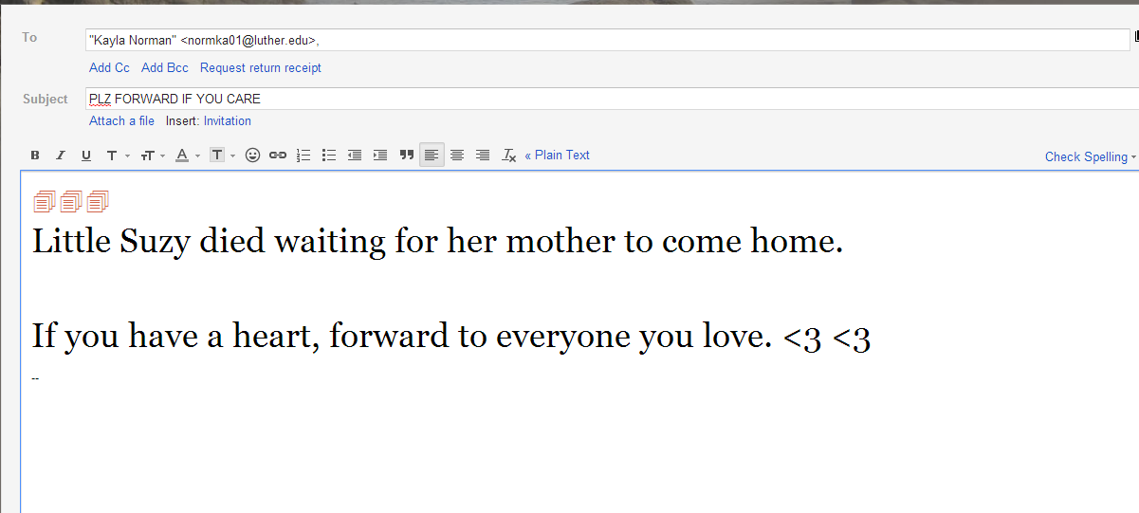
Example 3: Would this email be relevant to someone?

Slide 20
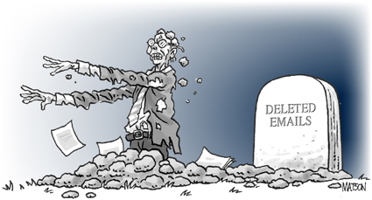
REMEMBER: When you send an email to someone, they are getting a copy that they can keep…forever.

Slide 21
Be Mindful of your email address
rockerboy113@yahoo.com is fine to use with friends but NOT to staff at high schools, colleges, businesses or any person you do not personally know.
Create a new address like jdoe@gmail.com or jd@yahoo.com
“Remember, simple and professional. No numbers, nick names
or references to cartoon characters…”

Slide 22
E-Mail Anatomy
To:
If you are creating a message, you may put in one or more e-mail addresses separated by commas.
Cc:
Send people courtesy copies.
Bcc:
Send a "blind" copy to another person. The "To" and "Cc" people won't know. If you are sending a group of people and don't want everyone to see the addresses, enter them as Bcc.
From:
Tells you the name and Internet address of the person who sent the message.

Slide 23
Your Turn
Write an email to a professor,
Introduce yourself
You would like this prof. to become your project supervisor
Show you are serious & qualified
Use proper English
Show that you know why the Prof. would be a good fit with your work (google her/his publications)
Be concise: 2-4 paragraphs.
Search and apply Signature to your university email

Slide 24
INFORMATION SYSTEMS Overview
Information Systems and Management

Slide 25
An Introduction to Information Systems
Information System:
An information system is a set of interrelated components that collect, manipulate, store data and disseminate information and provide a feedback mechanism to monitor performance.

Slide 26
What is an Information System?
An organized combination of people, hardware, software, communications networks, and data resources that collects data, transforms it, and disseminates information.

Slide 27
Data Vs. Information
Data: Raw unorganized facts
Information:
A collection of facts organized in such a way that they have additional value beyond the value of the facts themselves.
Defining and organizing relationships among data creates information.

Slide 28
Information Concepts
Process:
A set of logically related tasks performed to achieve a defined outcome.
Knowledge:
An awareness and understanding of a set of information and ways that information can be made useful to support a specific task or reach a decision

Slide 29
The Value of Information
The value of Information
is directly linked to how
it helps decision makers
achieve their organization’s
goals.

Slide 30
System
A system is a set of elements or components that interact to accomplish goals.

Slide 31
CBIS (Comp. based Info Sys)
Hardware:
Computer Equipment
Software:
Computer Programs
Databases:
An organized collections of facts

Slide 32
CBIS
Enables organizations to carry out their processes and tasks through effective computer networks.
Telecommunications:
Electronic transmission of signals for communication
Networks: Computers and equipment that are connected in a building, around the country, or around the world to enable electronic communications.
Internet: The world’s largest computer network, consisting of thousands of interconnected networks, all freely exchanging information.
Intranet: An internal network based on Web
technologies that allows people within an organization
to exchange information and work on projects.
Extranet: A network based on Web technologies
that allows selected outsiders, such as business
partners and customers, to access authorized
resources of a company’s intranet

Slide 33
CBIS
People
Procedures:
Strategies, policies, methods, and rules for using a CBIS.

Slide 34
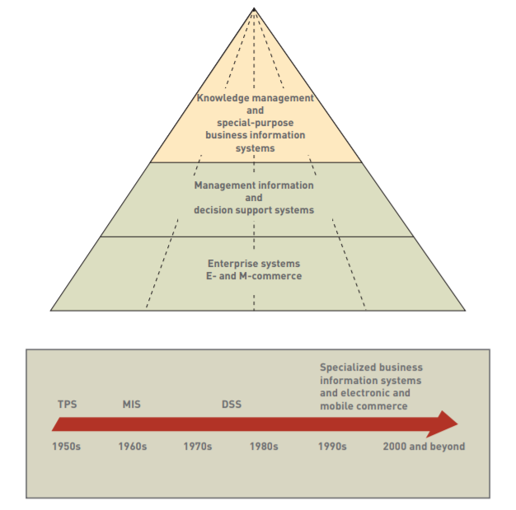
Business Information Systems

Slide 35
Electronic and Mobile Commerce
E-Commerce:
Any business transaction executed electronically between companies (business-to-business, or B2B), companies and consumers (business-to-consumer, or B2C), consumers and other consumers (consumer-to-consumer, or C2C).
M-Commerce:
The use of mobile, wireless devices to place orders and conduct business
Relies on wireless communications

Slide 36
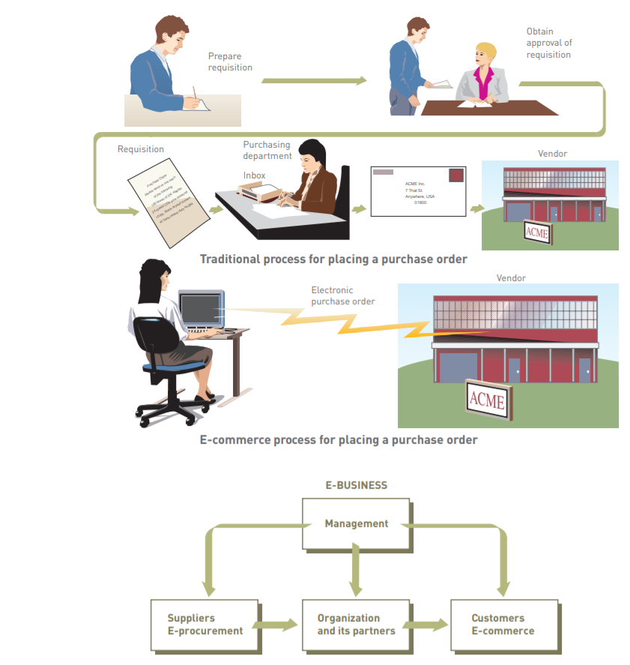

Slide 37
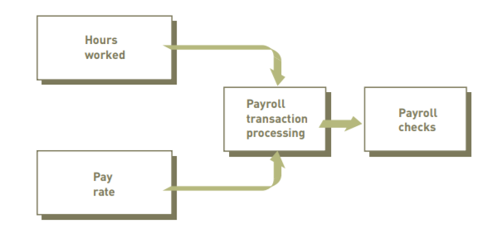
TPS
Transaction
A transaction is any business-related exchange such as payments to employees, sales to customers, or payments to suppliers.
Transaction Processing System (TPS)
TPS is an organized collection of people, procedures, software, databases, and devices used to perform and record business transactions.

Slide 38
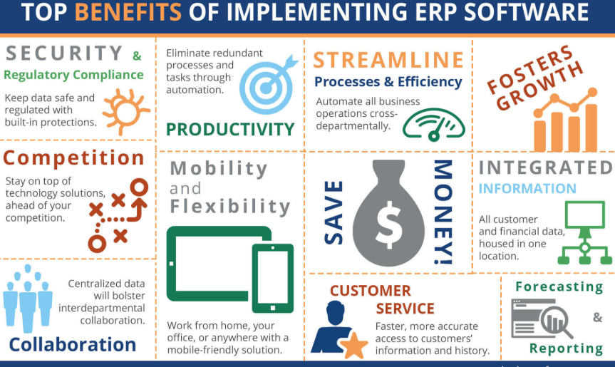
ERP
Enterprise Resource Planning (ERP)
A set of integrated programs for managing the entire business operations

Slide 39
Management Information System:
A system used to provide routine information to managers and decision makers. MISs typically provide standard reports generated with data and information from the TPS or ERP
Decision Support System:
A system used to support problem- specific decision making

Slide 40
Remember!
The focus of a DSS is on making effective decisions. Whereas an MIS helps an organization “do things right,” a DSS helps a manager “do the right thing”.

Slide 41
Information Systems in Society
Security, Privacy, Ethical Issues in Information Systems and the Internet.

Slide 42
Information System Activities
Input of Data Resources
Process Data into Information
Output of Information

Slide 43
Input of Data Resources
Data entry
Editing
Machine readable
Source documents
Formal record of a transaction
User interface
How users interact with information system
Optical scanning; menu; prompts; fill in blanks

Slide 44
Process Data into Information
Calculate
Compare
Sort
Classify
Summarize
The quality of the data must be maintained by a continual process of correcting and updating activities

Slide 45
Output of Information
Transmit information to users
Display; paper; audio
Storage of data
Data are retained in an organized manner
Fields; records; files; data bases
Control of system performance
Feedback must be monitored and evaluated to determine if the information system is meeting established performance standards

